Slide 1

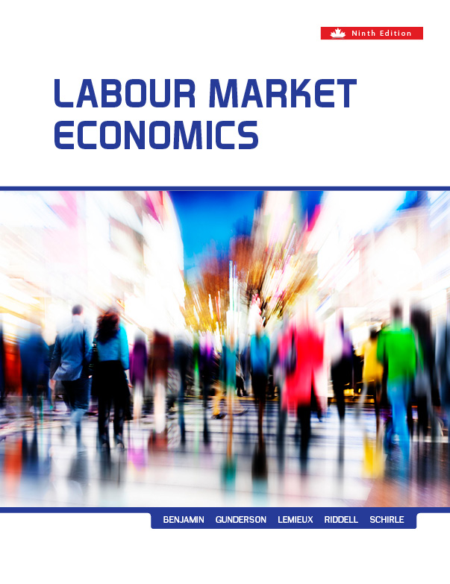
Chapter Fifteen
Union Impact on Wage and Nonwage Outcomes
Prepared by Dr. Mir Ahasan Kabir
York University

Slide 2
Learning Objectives
Discuss the difficulties in measuring the impact of unions on the wages of their members and the methodologies that are often used to overcome those difficulties.
Describe the mechanisms whereby unions may affect the wages of nonunion workers.
Explain how unions affect pay wage inequality and the distribution of income.
Discuss how the impact of unions may differ across various characteristics such as skill level, gender, the public and private sectors, and the degree of competition in the product market.
Describe how unions may affect productivity, investment, and the profitability of the firm, as well as overall efficiency in the economy as a whole.
© 2021 MCGRAW-HILL EDUCATION LTD.
15 - <number>

Slide 3
Main Questions
What are some of the difficulties of estimating the causal effect of unions on wages, and what are some of the newer procedures used to deal with those difficulties?
By how much are unions able to raise the wages of their members? Which types of workers benefit most?
What effects do unions have on the wages of non-union workers?
Do unions increase or decrease the overall degree of income inequality?
What effect do unions have on economic inefficiency?
Are there positive effects of unionization on labour productivity?
On balance, do unions reduce the profits of firms?
© 2021 MCGRAW-HILL EDUCATION LTD.
15 - <number>

Slide 4
Union Wage Impact
The basic two-sector model:
Measuring union–nonunion wage differential: the percentage difference in wages between union and nonunion workers
The basic predictions of the model:
  Union results in a worker's wage increase but decline in employment in that sector
  Union employment will rise in nonunion sector resulting in a wage decrease there
© 2021 MCGRAW-HILL EDUCATION LTD.
15 - <number>

Slide 5
Union Wage Impact
Further impacts of unionization :
Nonunion firms will raise wages to compete with unionized firms for the work force
Union sector may get the top applicants
Nonunion employers may raise wages in order to reduce the threat of their employees to become unionized (threat effect)
The threat effect is greater when:
  The union wage is high
  The nonunion sector is easy to organize
  The potential union is aggressive
  Employers have a strong aversion to unionization
© 2021 MCGRAW-HILL EDUCATION LTD.
15 - <number>

Slide 6
Union Wage Impact
Union Wage Impact in a two-sector model:
Both sectors start with competitive wage W₀
Union raises wages from W₀ to W_{u} , creating a reduction in employment
Displaced workers are shifting to the nonunion sector and, increasing the supply of labour and, hence, reducing the wages from W₀ to W_{N}
© 2021 MCGRAW-HILL EDUCATION LTD.
15 - <number>

Slide 7
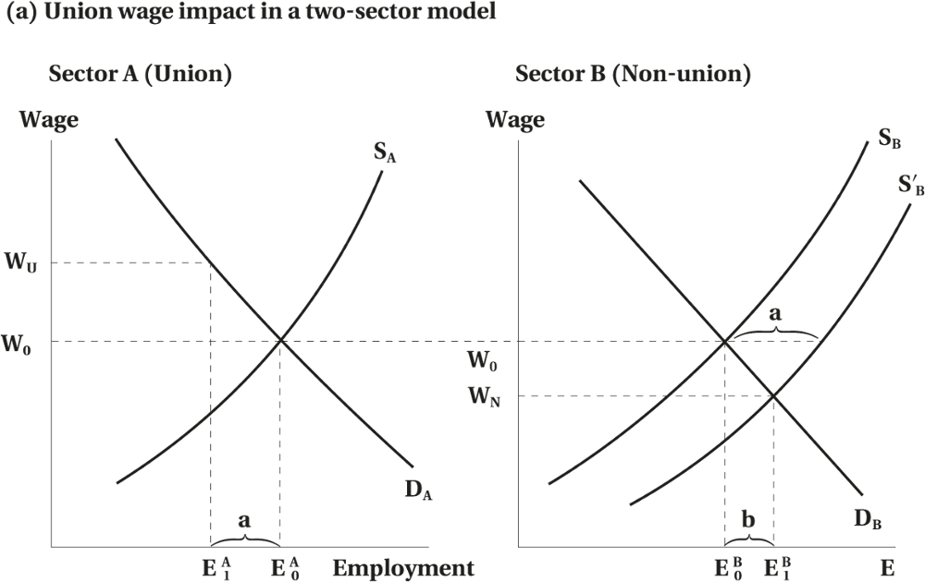
Union Wage Impact
Figure 15.1 Two-Sector Model of General Equilibrium
© 2021 MCGRAW-HILL EDUCATION LTD.
15 - <number>

Slide 8
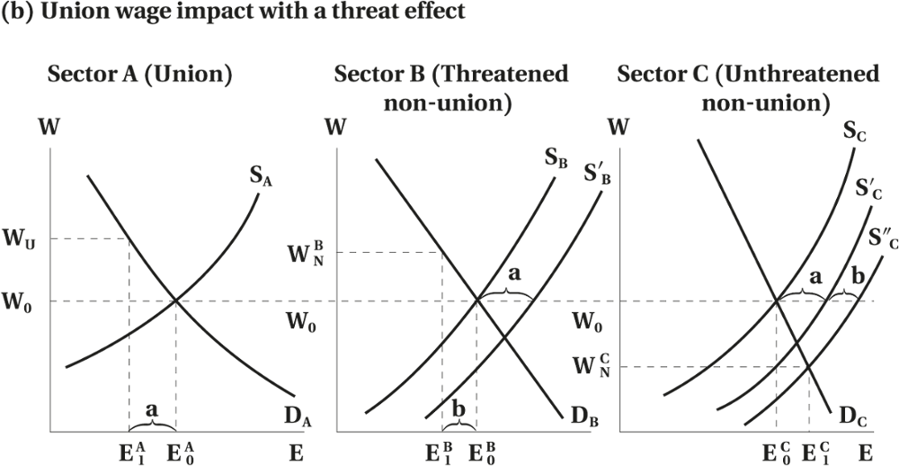
Union Wage Impact
Figure 15.1 Two-Sector Model of General Equilibrium
© 2021 MCGRAW-HILL EDUCATION LTD.
15 - <number>

Slide 9
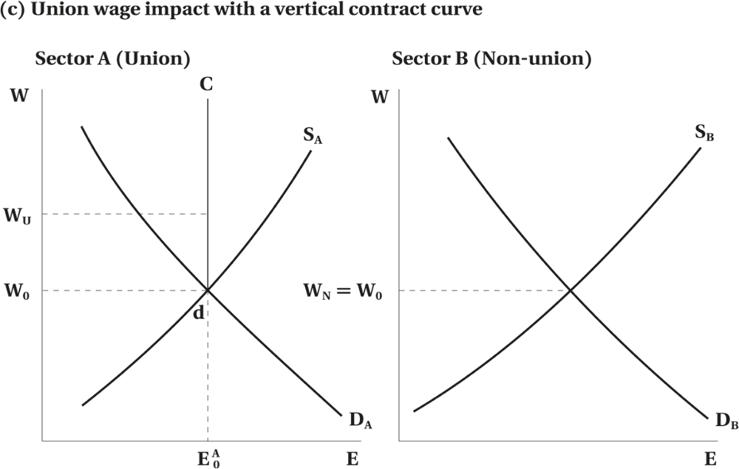
Union Wage Impact
Figure 15.1 Two-Sector Model of General Equilibrium
© 2021 MCGRAW-HILL EDUCATION LTD.
15 - <number>

Slide 10
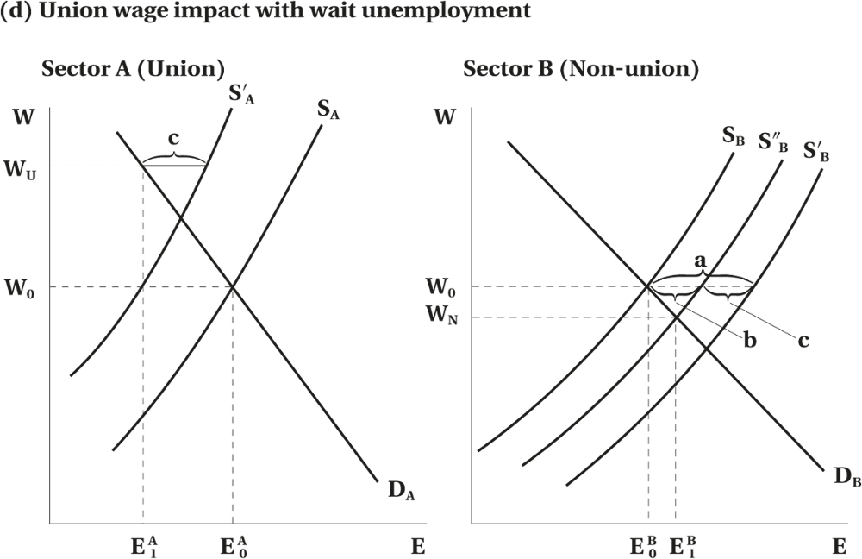
Union Wage Impact
Figure 15.1 Two-Sector Model of General Equilibrium
© 2021 MCGRAW-HILL EDUCATION LTD.
15 - <number>

Slide 11
Union Wage Impact
Wait or queue unemployment:
Workers that are unable to obtain a job in union sector will seek one in nonunion
It will be rational to wait for union job because its higher pay
The increase in supply in nonunion sector will be less than the reduction in employment in the union sector
© 2021 MCGRAW-HILL EDUCATION LTD.
15 - <number>

Slide 12
Union Wage Impact
To estimate the pure union–nonunion wage differentials, we need to control for several factors:
  Skills difference factor
  Labour quality
  Differences in the characteristics of job assignments of workers
  Education, training, and experience
  Productivity related factors
© 2021 MCGRAW-HILL EDUCATION LTD.
15 - <number>

Slide 13
Union Wage Impact: Empirical Evidence
The main findings indicate:
Unions cause higher wages
Union–nonunion wage differential is 10–20 percent for the U.S. economy as a whole
Union–nonunion wage differential is 10–25 percent for Canadian economy as a whole
Higher wages make unionization more likely
Longitudinal Studies:
Longitudinal data contains observations on the same individual over time
The estimated union–nonunion wage differential is reduced to approximately 10 percent
Deficiencies in longitudinal studies
© 2021 MCGRAW-HILL EDUCATION LTD.
15 - <number>

Slide 14
Variation in the Union Wage Impact
Variation by Union Density
  The union–non-union wage differential tends to be larger when a high proportion of the relevant jurisdiction (industry, occupation, region) is organized.
  Nonlinear Relationship
Variation by Firm Size
  Firm or establishment size has also been found to be positively related to both union and non-union wages.
  The relationship is considerably stronger for non-union workers
© 2021 MCGRAW-HILL EDUCATION LTD.
15 - <number>

Slide 15
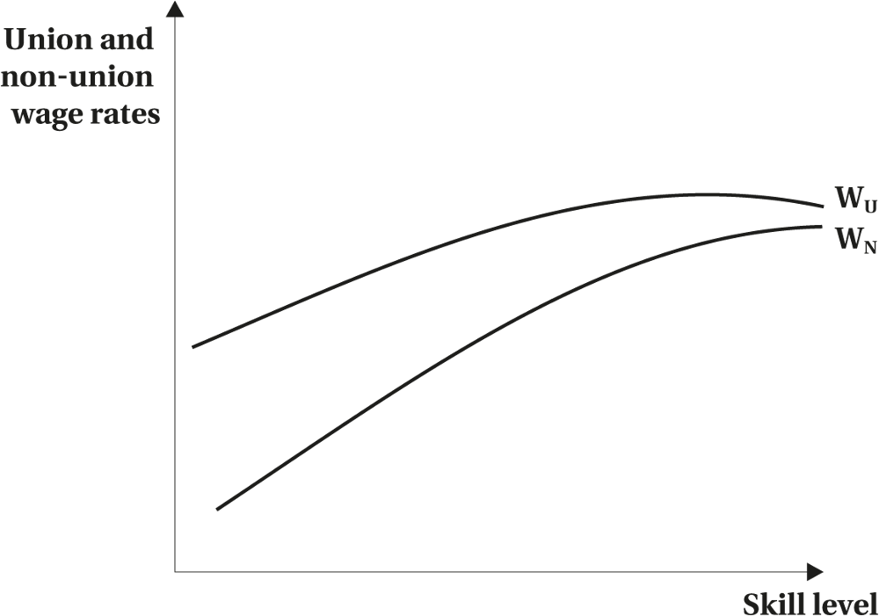
Variation in the Union Wage Impact
Figure 15.2 The Relationship between Union and Non-union Wages and Personal Characteristics
© 2021 MCGRAW-HILL EDUCATION LTD.
15 - <number>

Slide 16
Variation in the Union Wage Impact
Variation by Industry
Variation by Public and Private Sector
University Salaries
Variation by Gender
Effect on Non-union Workers
Effect on CEO Compensation
Variation Over the Business Cycle
Variation Over Time
© 2021 MCGRAW-HILL EDUCATION LTD.
15 - <number>

Slide 17
Variation in the Union Wage Impact
Some empirical findings:
Union wage gap is highest among low skilled workers
Union wage premiums tend to be lower when the sector is subject to greater foreign competition
Wage impact tends to be smaller in the public sector
Union and nonunion wages are equally responsive to gender
Unionism has lowered the wages of nonunion workers
Union wages exhibit less cyclical variation
© 2021 MCGRAW-HILL EDUCATION LTD.
15 - <number>

Slide 18


Variation in the Union Wage Impact
Worked Example
Analyzing the Union–Non-union Earnings Differentials
What do these coefficients imply about union wage-setting practices?
Calculate the expected earnings for the average union and non-union worker.
What is the total or “raw” union–non-union earnings differential?
© 2021 MCGRAW-HILL EDUCATION LTD.
15 - <number>

Slide 19
Variation in the Union Wage Impact
What are the expected earnings that a union worker would receive if paid according to the non-union pay structure?
  Y_{U}* = 8000 + 2000(12) + 500(10) = $ 37,000.
What is the pure union earnings premium
  Y_{U} − Y_{U}* = $ 44,000 − $ 37,000 = $ 7000
© 2021 MCGRAW-HILL EDUCATION LTD.
15 - <number>

Slide 20
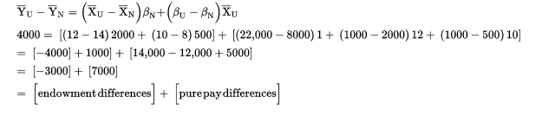
Variation in the Union Wage Impact
Use the Blinder-Oaxaca decomposition to decompose the average union–non-union earnings difference
© 2021 MCGRAW-HILL EDUCATION LTD.
15 - <number>

Slide 21
Union Wage Impact: Summary
Substantial evidences of a significant wage differential between union and non-union workers
The overall impact of higher wages in the union sector on the average wage in the non-union sector is both theoretically and empirically inconclusive.
Wage differences among unionized workers who differ according to various productivity-related personal characteristics are smaller than in non-union enterprises.
The union–non-union wage differential is generally higher in the private than the public sector.
Unionization likely lowers the total compensation of CEOs.
© 2021 MCGRAW-HILL EDUCATION LTD.
15 - <number>

Slide 22
Unions, Wage Dispersion, and the Distribution of Income
In Canada there is less wage dispersion among union workers
Unions have larger impact on blue collar wages
Net effect of unionism is to reduce wage dispersion
Unions reduce wage inequality
© 2021 MCGRAW-HILL EDUCATION LTD.
15 - <number>

Slide 23
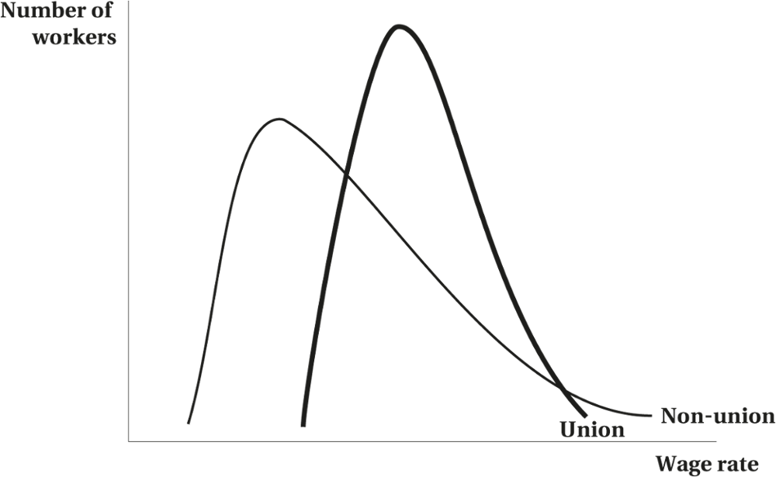
Unions, Wage Dispersion, and the Distribution of Income
Figure 15.3 Wage Dispersion in the Union and Non-union Sectors
© 2021 MCGRAW-HILL EDUCATION LTD.
15 - <number>

Slide 24
Union Impact on Resource Allocation and Economic Welfare
Unions affect the allocation of labour and other resources in the economy due to wage and employment alterations
Changes in wages and employment result in inefficient allocation of resources and reduction in output
© 2021 MCGRAW-HILL EDUCATION LTD.
15 - <number>

Slide 25
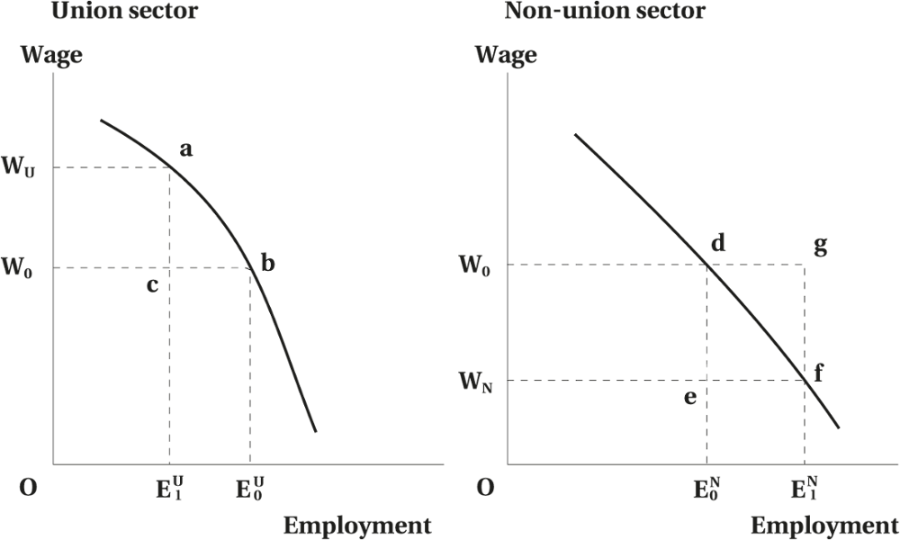
Union Impact on Resource Allocation and Economic Welfare
Figure 15.4 The Union Wage Impact and Allocative Inefficiency
© 2021 MCGRAW-HILL EDUCATION LTD.
15 - <number>

Slide 26
Union Impact on Resource Allocation and Economic Welfare
With absence of unions the wage in both sectors is W₀
With higher union wage W_{u}, the employment level declines in the union sector (E₁^{U}) and increases in the nonunion sector (E₁^{N})
The wage in the nonunion sector declines to W_{N}
The income is lower as well—equals to the sum of both shaded areas
Dead weight losses: areas abc and dgf = def
© 2021 MCGRAW-HILL EDUCATION LTD.
15 - <number>

Slide 27
Union Impact on Resource Allocation and Economic Welfare
The reduction in the value of total output is a deadweight loss
Higher wages and reduced employment in the union sector push workers into less productive and lower paying jobs
The Existence and the magnitude of deadweight loss associated with the union wage will depend on:
  Elasticity of labour supply
  Amount of queuing and unemployment
  The extent to which firms and unions negotiate wage–employment outcomes
© 2021 MCGRAW-HILL EDUCATION LTD.
15 - <number>

Slide 28
Union Impact on Nonwage Outcomes
Union and Fringe Benefits
Nonwage benefits account for a higher proportion of total compensation among union than nonunion firms
Workers prefer fringe benefits because they are not being taxed
The benefits provide work incentives and reduce turnover
© 2021 MCGRAW-HILL EDUCATION LTD.
15 - <number>

Slide 29
Union Impact on Nonwage Outcomes
Union and Fringe Benefits:
Unions represent the wishes of the median voter
Nonunion organizations represent the wishes of marginal worker
The demand for fringe benefits increases with age and packages in unionized firms will devote greater share of them
© 2021 MCGRAW-HILL EDUCATION LTD.
15 - <number>

Slide 30
Union Impact on Nonwage Outcomes
Union Impact on Employment:
Employers substitute away from higher cost union labour
Higher cost of workers will tend to raise the price of output
Union will bargain in terms of levels of employment
Unions may impose featherbedding rules that fix the ratio of labour to capital
Unions will restrict the use of cheaper labour
© 2021 MCGRAW-HILL EDUCATION LTD.
15 - <number>

Slide 31
Union Impact on Nonwage Outcomes
Union Impact on Working Conditions:
Nonunion firms tend to be less rules oriented
Nonunion firms tend to exhibit more worker and management flexibility
More structured work setting and less flexible hours in nonunion firms
Faster work pace in nonunion firms
© 2021 MCGRAW-HILL EDUCATION LTD.
15 - <number>

Slide 32
Union Impact on Nonwage Outcomes
Union Impact on Turnover
Quit rate is lower in unionized firms
Differed compensation is more prevalent in unionized firms
© 2021 MCGRAW-HILL EDUCATION LTD.
15 - <number>

Slide 33
Union Impact on Nonwage Outcomes
Union Impact on Productivity, Profitability, and Investment
Union firms will utilize more capital
Union firms will hire more productive labour
Union has a positive effect on productivity, morale, and cooperation
Union may improve the communication between labour and management
© 2021 MCGRAW-HILL EDUCATION LTD.
15 - <number>

Slide 34
Chapter Summary
Union wage impact: effect and consequences
Two sector model: union vs. nonunion employment and wages
Wait unemployment cause and effect
Union vs. nonunion wage differences
Impact of union on wage and conditions of employees
Economic welfare and unions
Fringe benefits and influences
Union impact on employment, working conditions, turnover, and productivity
© 2021 MCGRAW-HILL EDUCATION LTD.
15 - <number>

